Slide 1

Analyzing Tree Health Using G-LiHT Data
Aliya Alimujiang
Minh Nguyen
2021
Notes:
use high-resolution 3D data from unmanned aerial vehicles (UAV) and piloted aircraft to improve models of biomass and phenology at the scale of the individual tree crown.

Slide 2

OVERVIEW Motivation Descriptive Analytics Parametric Nonparametric Conclusion Appendix

Slide 3
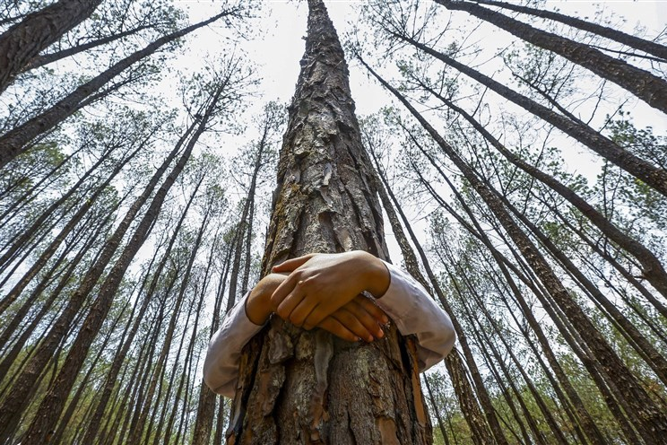

Motivation
Why tree health?
The future is at stake
Private and Governments partnership
“Green” $2.3T plan
Why this project?
Great power comes great responsibility - Uncle Ben
Venture into point cloud
Notes:
Why we want to learn? / Why is it important to learn about tree health? / Why is it relevant?
$$$ invested and funded
Original project?
NASA sponsors and covid, we pivoted
Prof suggested to work with what he has of an Alaskan boreal forest predicting tree health (Alive or Dead)

Slide 4
Descriptive Analytics & Feature Engineering
Point Cloud to Tree

Slide 5
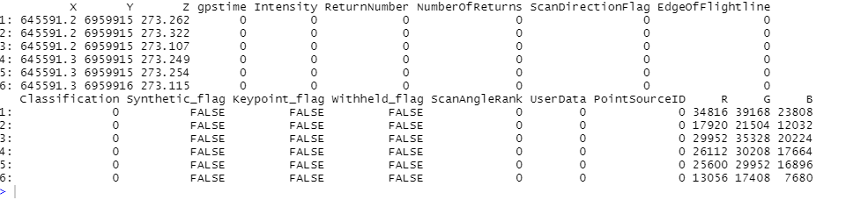
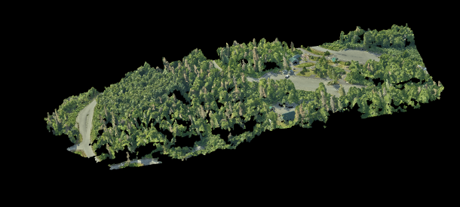
Initial Exploration of Variables:
Notes:
Read all las files from client data folder.
5 regions (mid, north, south1, south2 and south3), we created a loop to combined the las files into one large las file (main) and added the correct region attribute of the main las file.
Finally, reproject the shapefile that we created on ArcMap to our main las file by creating a get_las_crowns function that takes in two arguments (first argument = las file, second argument = shape file) and provide a las file with treeid and shape id while removing all elements with “NA” treeid.
Note: Shape id was permenantly written onto our las file using add_lasattribute. This allows us to retain a unique id for each of our tree if we ever need it. Treeid attribute was not retained when we write our las file since it is non-numeric.

Slide 6
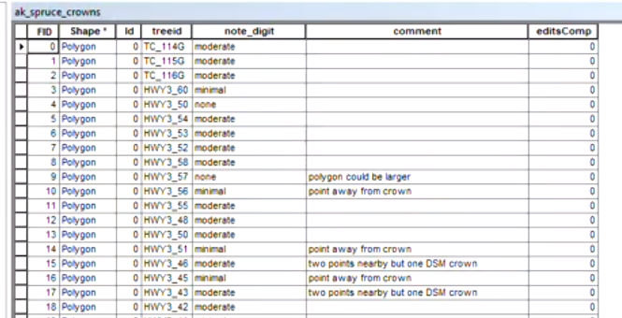
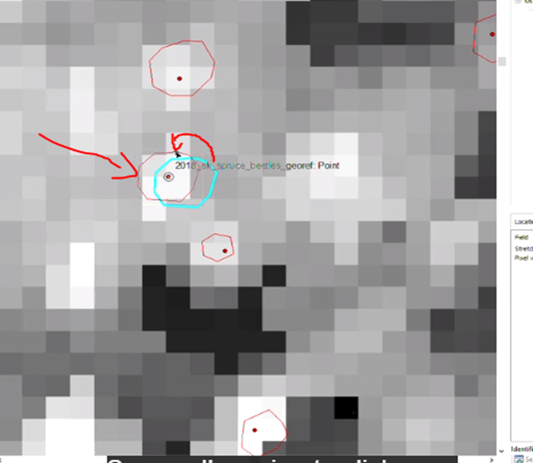
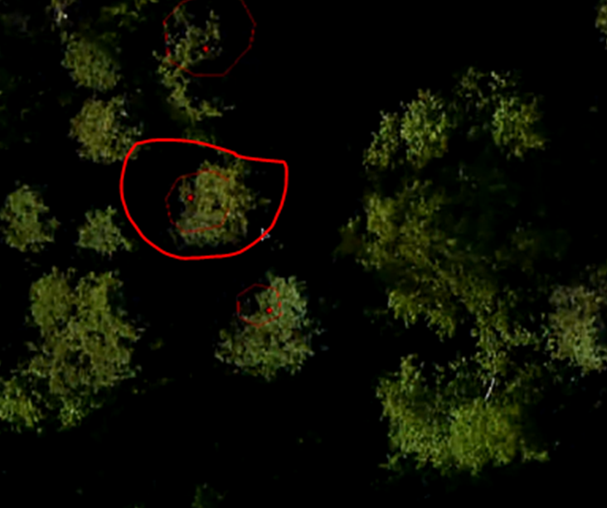
Initial Exploration of Variables on ArcMap:
Structure From Motion
Notes:
Structure From Motion
What are we looking for ? We can see from the picture on the left that the crown is a little small. We verify this with the Digital surface model below. We can say confidently that all the brightness which represents the height will need to be included. So, we moved the blue circle to where red circle is to improve the data accuracy.
Ultimately, the goal is to make sure we have most information stored underneath the crown extracted. Better the data quality, better the prediction accuracy.

Slide 7
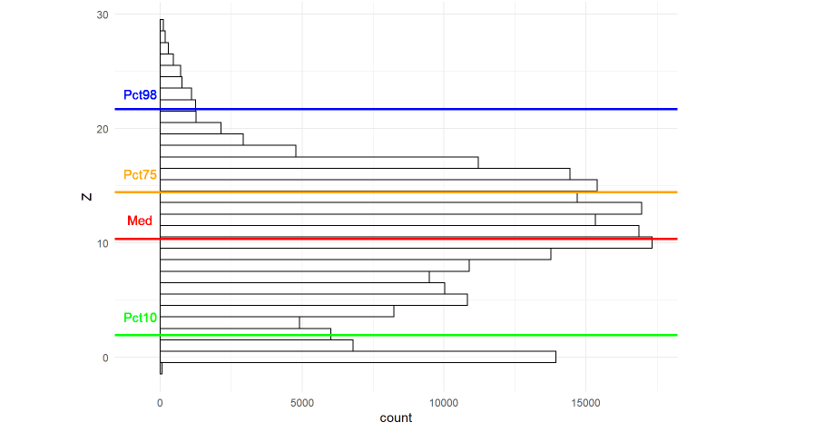
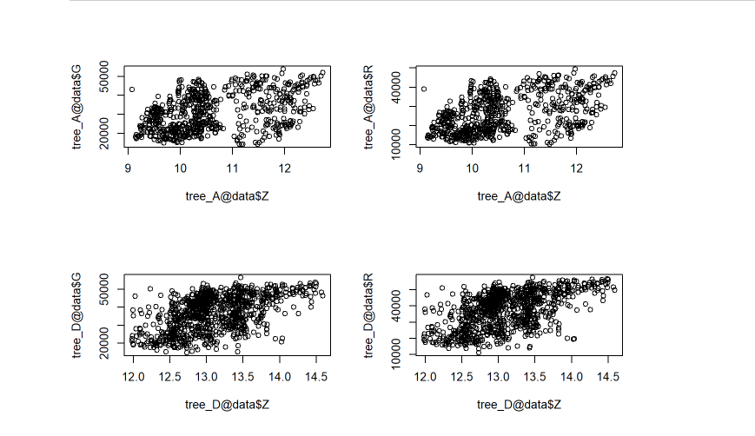
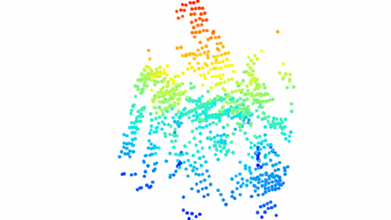
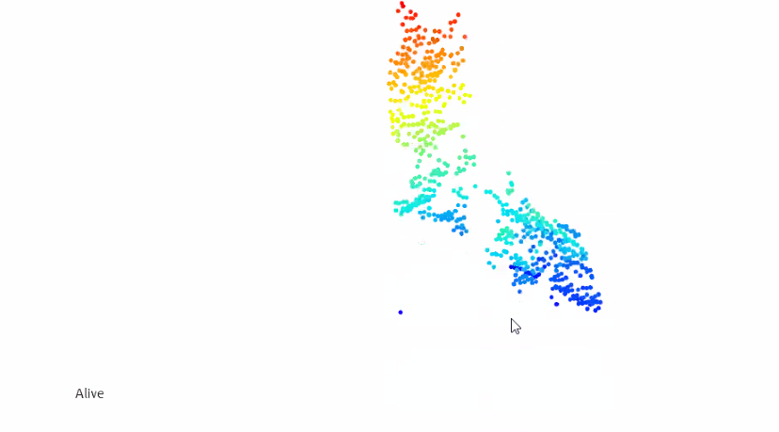
Point Cloud Analysis
Notes:
The first chart show our point cloud distribution
We randomly selected 1 alive and one dead trees to visualize
The left 3d tree plot shows that alive tree appears to be thinner while the dead one appears to be a bit more stumpy
Here we compare the G and R distributions between the 2 trees. Both G and R appear to be more dominant in A vs D

Slide 8
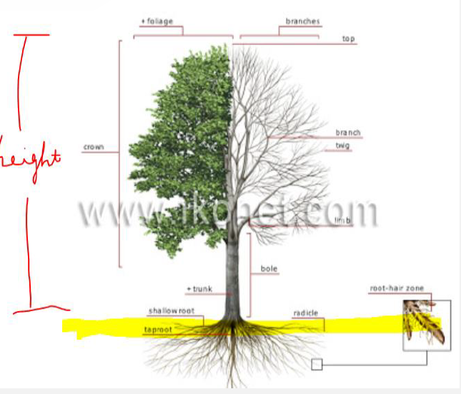
How did we go from 6 to 53 variables?
Structural Variables (X, Y, Z):
ht_90p: Height at 90%
ht_skw_Sp: Height skewness
Spectral Variables (R, G, B):
greenness_75p: Green ratio at 75% height
green_norm_mean: Mean of Green over all Colors
G_R_ratio_2: (G - R)/(G + R)
The full list is in the Appendix II.
Notes:
Compare a few types of variables that we extracted

Slide 9
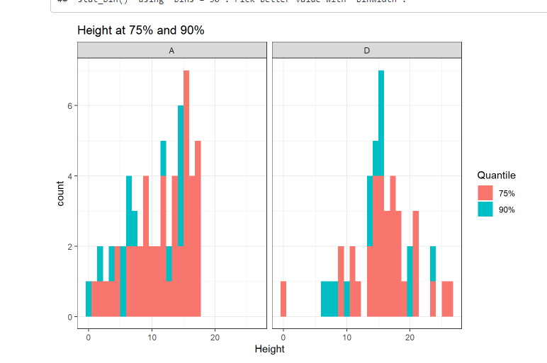
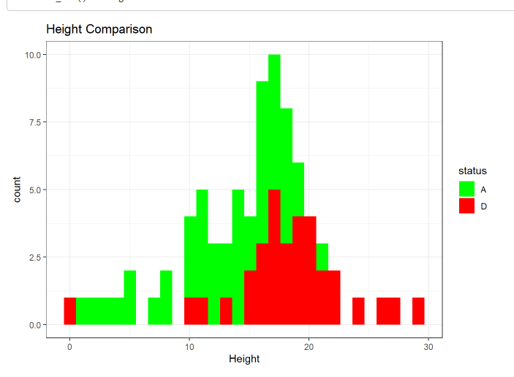
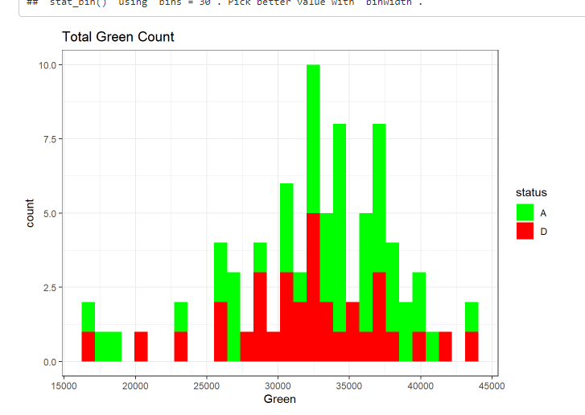
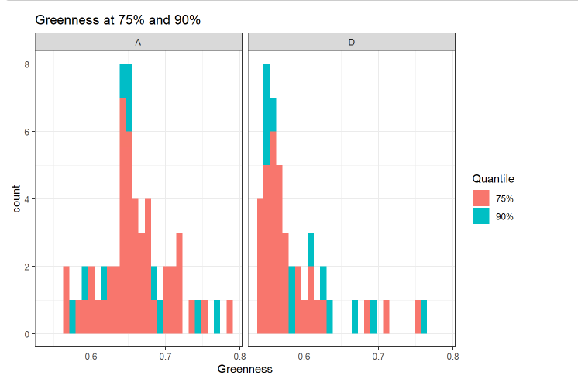
Notes:
In these plots we look at the distribution of Alive and Dead trees after we extract features and minimized our dataset to 1 row per tree
We also checked some of our basic assumptions here:
* Total Green Count (A vs D)
+ You can see that Alive trees appear to have higher Green values
* Greenness (ratio of green) at 75% and 90%
+ Alive trees appear to have a more "normal" Greeness distribution with peak around 0.65
+ Dead trees appear to be skewed to the right with most of the Greeness less than 0.6
* Height Comparison (A vs D)
+ Alive trees appear to be less sparse
* Height at 75% and 90%
+ Alive trees appear to be less sparse at both 75% and 90% height

Slide 10
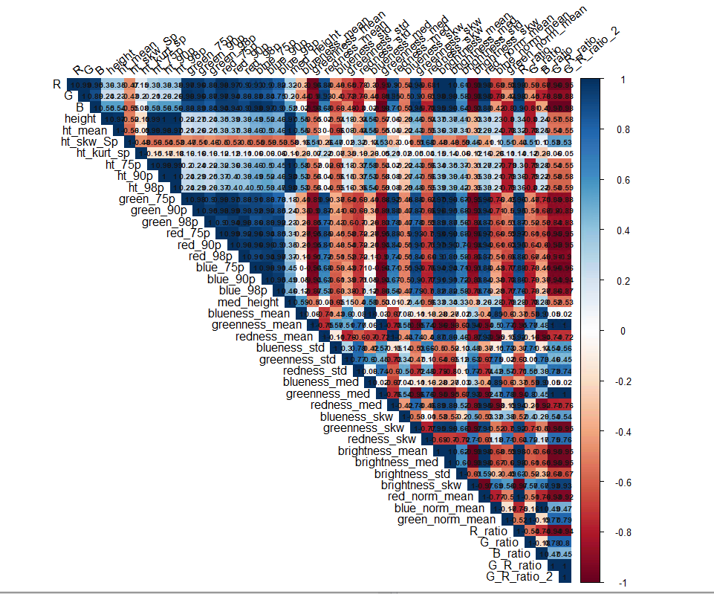
Notes:
It is hard to fully see our multicolinearity issue in the plot below due to having too many variables. However, you can clearly see the strong blue (positive correlation) and red (negative correlation) in the plot.

Slide 11
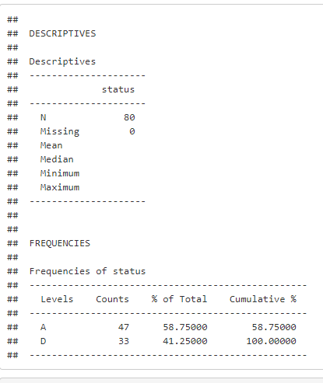
n is not much larger than p, then there can be a lot of variability in the least squares fit resulting in overfitting and consequently poor predictions on future observations not used in the training model.
Bias VS Variance trade off : By constraining or shrinking the estimated coefficients, we can often substantially reduce the variance at the cost of a negligible increase in bias.
Notes:
The final data frame to be used in our models has 80 observations: 47 Alive (A) and 33 Dead (D) trees, 58.75% and 41.25% respectively.
We will be using Accuracy and Kappa Coefficient of Agreement to compare our models in subsequent sections. Kappa essentially lets us know how much better are our models (information/algorithmic efficiency) than chance.

Slide 12
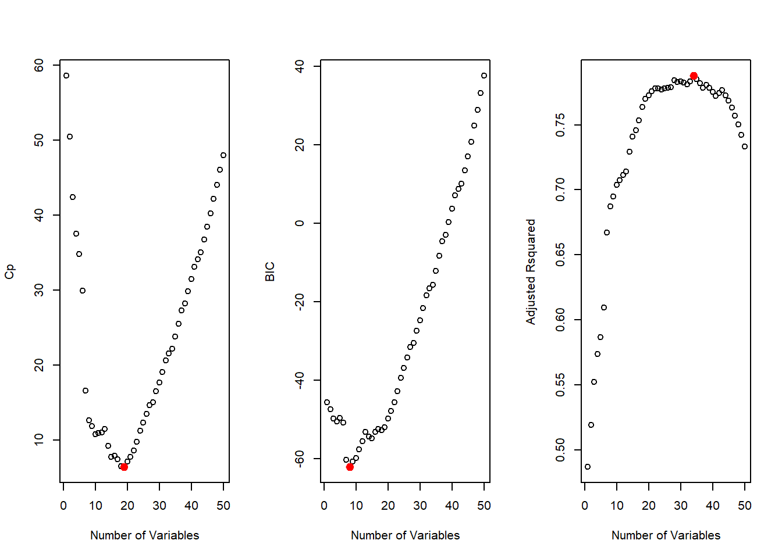
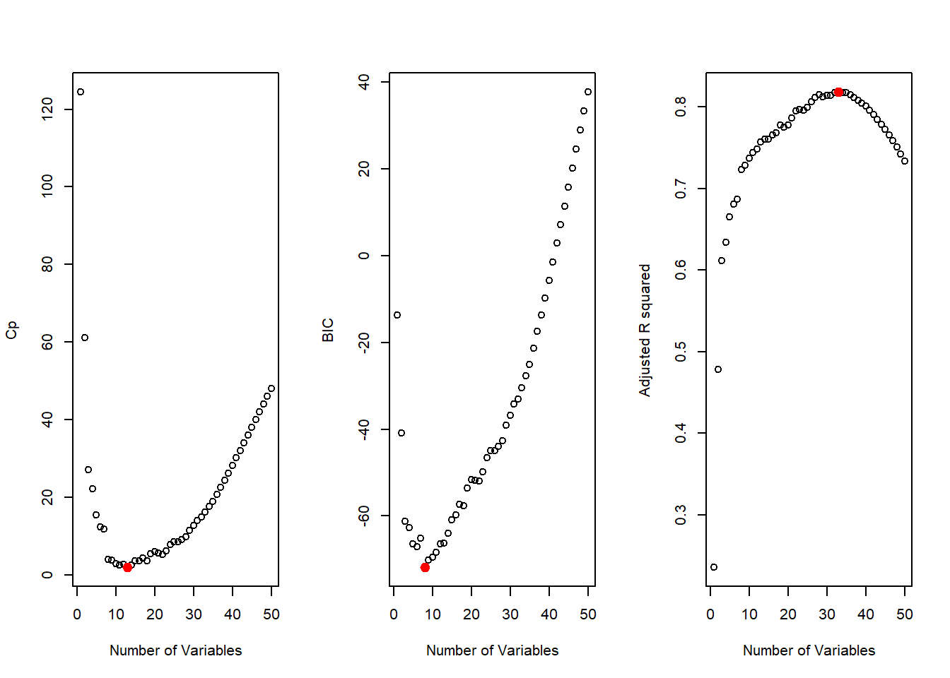
Variable Selection – Summary
Forward
Backward

Slide 13
Variable Selection – Which Variables?
Forward
Backward
ht_98p
green_98p
red_98p
brightness_std
red_norm_mean
G_ratio
G_R_ratio_2
green_norm_mean
B_ratio
red_75p
redness_75p
redness_98p
blue_norm_mean
R_ratio
G_R_ratio
green_norm_mean
B_ratio

Slide 14
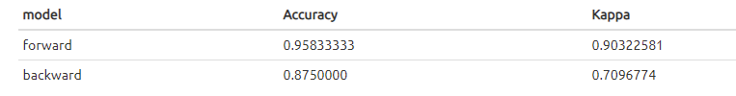
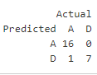
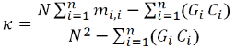


Logistic Regression
Forward
Backward
Notes:
Producer’s accuracy = sensitivity and specificity
User’s Accuracy = row A or D/row total of A or D
The kappa coefficient measures the agreement between classification and truth values. A kappa value of 1 represents perfect agreement, while a value of 0 represents no agreement.

Slide 15
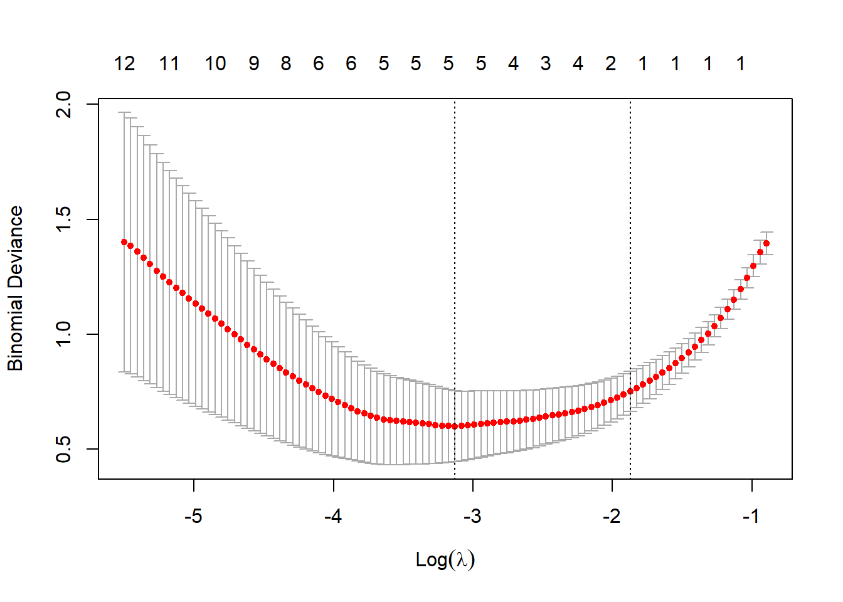

LASSO
Variables:
green_98p
greenness_std
blueness_med
brightness_skw
G_ratio
Accuracy: 0.825
Kappa: 0.61538462

Slide 16
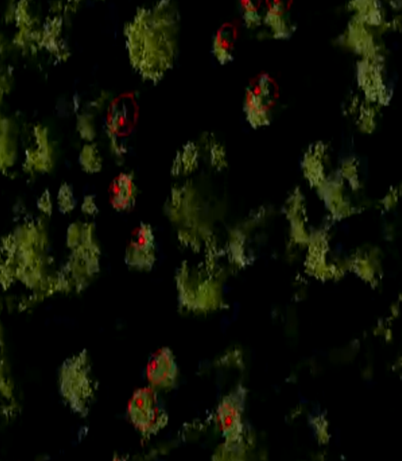
Random Forrest
Intuition: P >> N
All 53 Variables Used
Hyperparameters: mtry, maxnode and ntree
Notes:
Might help with correlation.

Slide 17
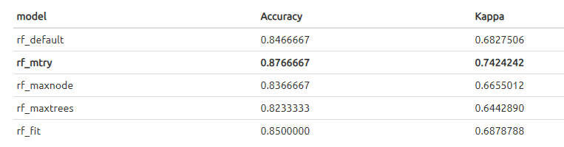
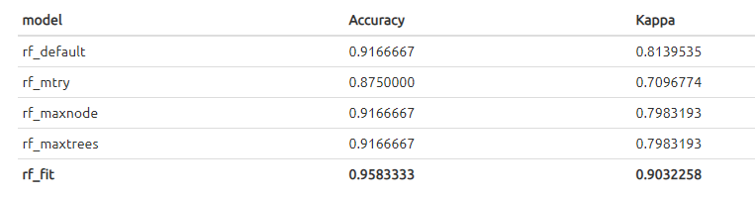
Random Forrest – Accuracy and Kappa
Initial Run
Test Data
Notes:
From our training results, the rf_mtry model appears to perform the best with about 87.67% accuracy and 68.28% kappa using mtry=16.
However, when we ran the models against our test set, our rf_fit/final model performed the better with 95.83% accuracy and 90.32% kappa. After running our Random Forest model with various mtry, maxnode and ntree hyperparameters, we settled on 16, 7 and 450 respectively.

Slide 18
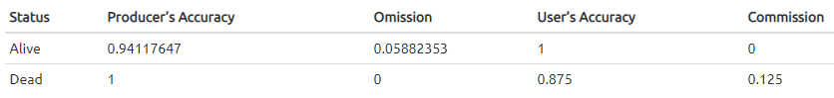
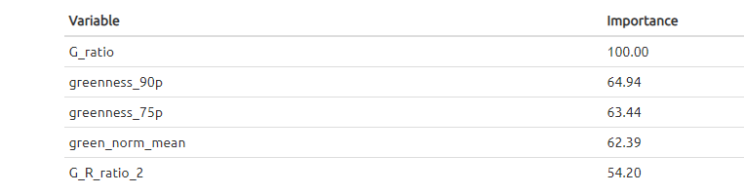
Random Forrest - Assessment
Accuracy Assessment
Top 5 Importance Variables
Notes:
Accuracy Assessment for rf_fit model:
Below is the table of the top 5 importance variables for our final model (rf_fit):

Slide 19
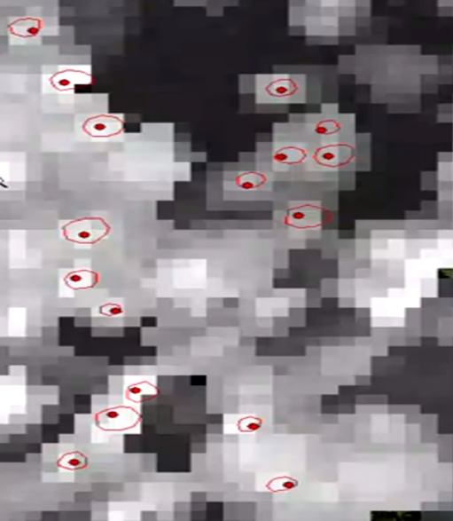
Support Vector Machine
Intuition: Captures complex relationships between our trees
Hyperparameters: Linear/Radial, Cost, and sigma
All 53 Variables Used
Notes:
Capture much more complex relationships between your datapoints without having to perform difficult transformations on your own (tend to be slow)

Slide 20
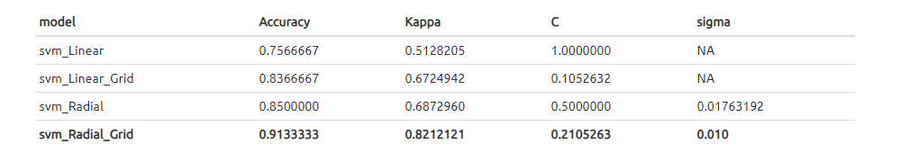
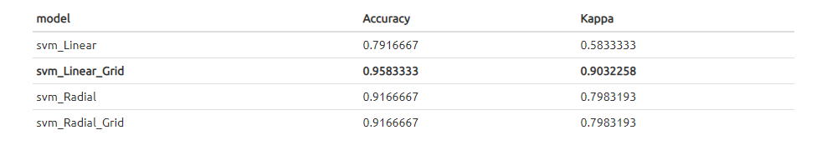
SVM – Accuracy and Kappa
Initial Run
Test Data
Notes:
From our training results, the radial SVM non-linear model appears to perform the best with about 90.67% accuracy and 80.45% kappa using C=0.0.2105263 and sigma=0.010.
However, when we ran the models against our test set, our svm_Linear_Grid model performed better with about 95.83% accuracy and 90.32% kappa.

Slide 21

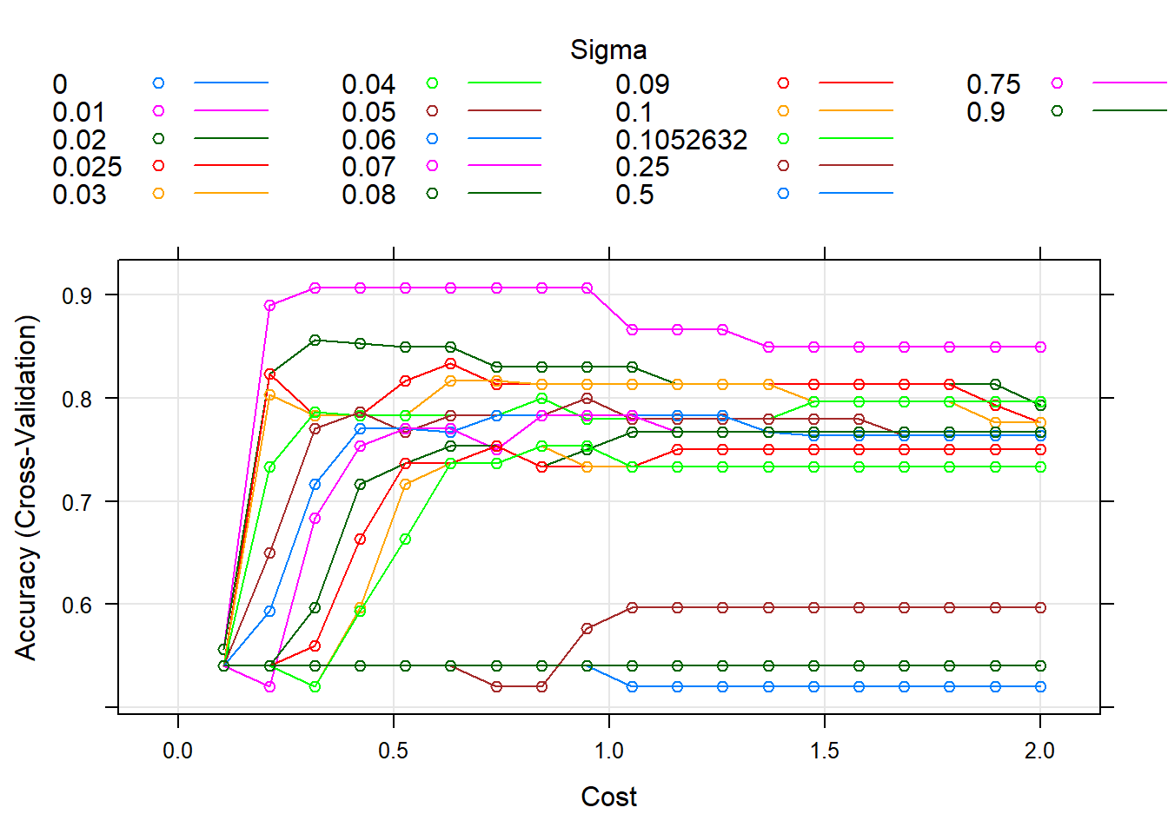
SVM – Assessment
Accuracy Assessment

Slide 22
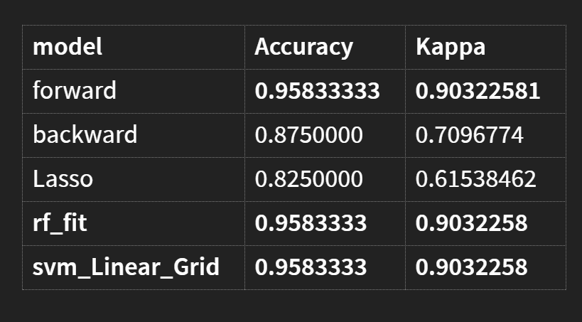
All Model comparison
Forward performed just as well in THIS DATASET
Binary question
Our recommended model
Might change with more observations

Slide 23
Next Steps
Missing SFM
Literature Review
Feature Extraction
Gather more data
Augmentation
Artificial Data
Notes:
Gather data and literature review = better feature extraction
Common Augmentation methods: rotation or scaling of data
Artificial Data using various X-variables distance
Address missing SFM which reduced our already small dataset

Slide 24

Thank you!

Slide 25
Appendix

Slide 26
Appendix I – References
Dr. Alonzo and ENVS-685 Remote Sensing
NASA G-LiHT data
Tree species classification from airborne hyperspectral and LiDAR data using 3D convolutional neural networks
Urban tree species mapping using hyperspectral and lidar data fusion
Mapping tall shrub biomass in Alaska at landscape scale using structure-from-motion photogrammetry and lidar
Estimation of standing dead tree class distributions in northwest coastal forests using lidar remote sensing
Silvi-Net–A dual-CNN approach for combined classification of tree species and standing dead trees from remote sensing data
Species-related single dead tree detection using multi-temporal ALS data and CIR imagery
Distinguishing between live and dead standing tree biomass on the North Rim of Grand Canyon National Park
Detection of Standing Deadwood from Aerial Imagery Products: Two Methods for Addressing the Bare Ground Misclassification Issue
Individual tree segmentation from a leaf-off photogrammetric point cloud
Non-destructive aboveground biomass estimation of coniferous trees using terrestrial LiDAR

Slide 27
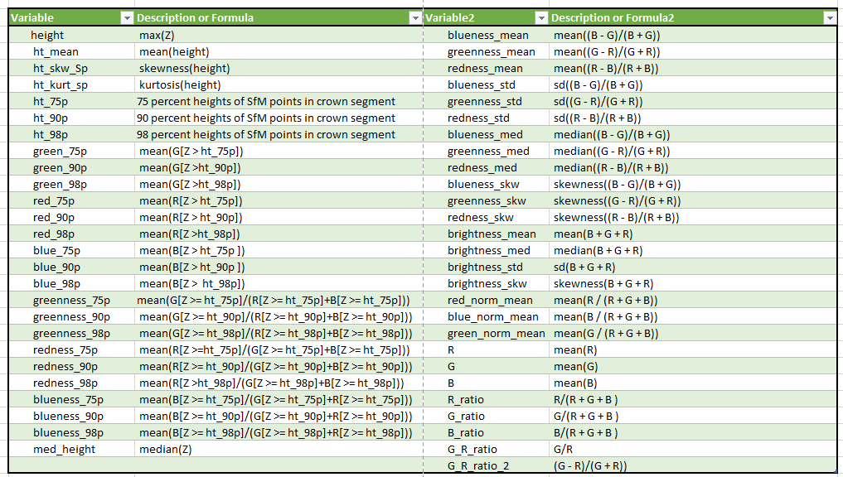
Appendix II – Variables Dictionary

